Slide 1




Sma3ny
Supervised By: Marwan Ahmed
October 2024

Slide 2


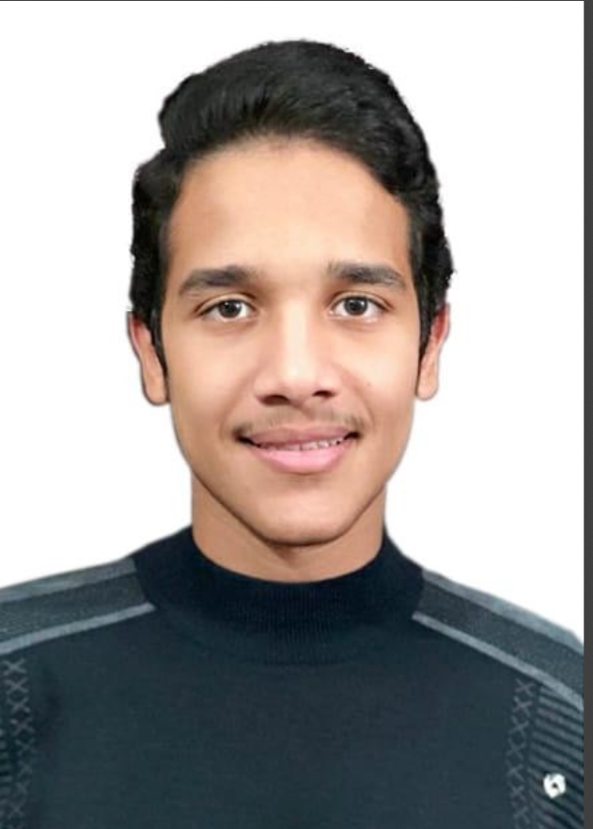




Our Team
Maya Ahmed Abdullah
Zahy Youssef
Reem Wael
Speech to Text Models
Translation Models
Sentiment Analysis Models
Basma Elhoseny
Youssef Hesham
Usama Muhammad
Deployment
Frontend
Integration of Models

Slide 3

Core Services
Speech-to-Text Conversion: Users can speak in either Arabic or English, and the app will accurately transcribe their speech into written text.
Multilingual Translation: The transcribed text can be automatically translated between Arabic and English, ensuring smooth communication between users of different language backgrounds.
Sentiment Analysis: After transcription and translation, the app performs sentiment analysis on the text to detect the emotional tone. The emotions classified include Neutral, Positive or Negative.

Slide 4
Project Pipeline

Slide 5
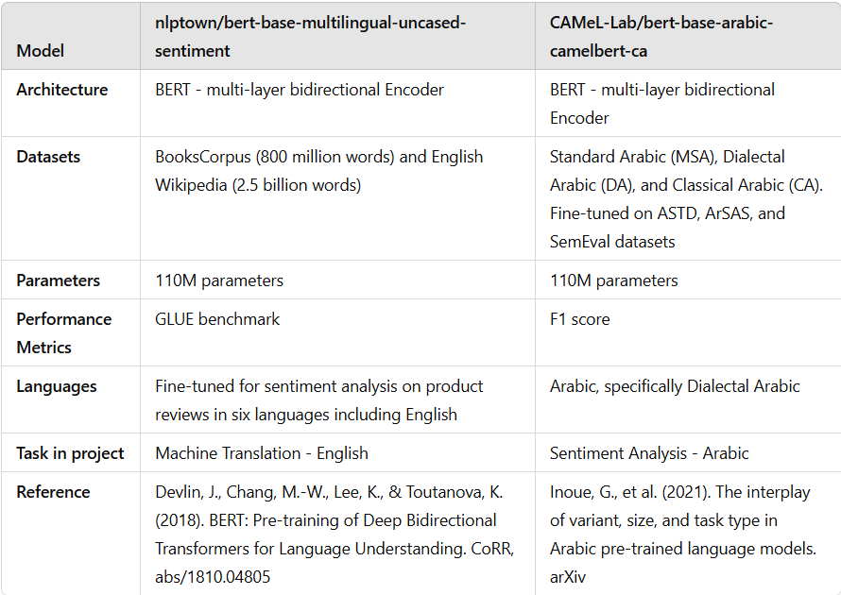
Model Details

Slide 6
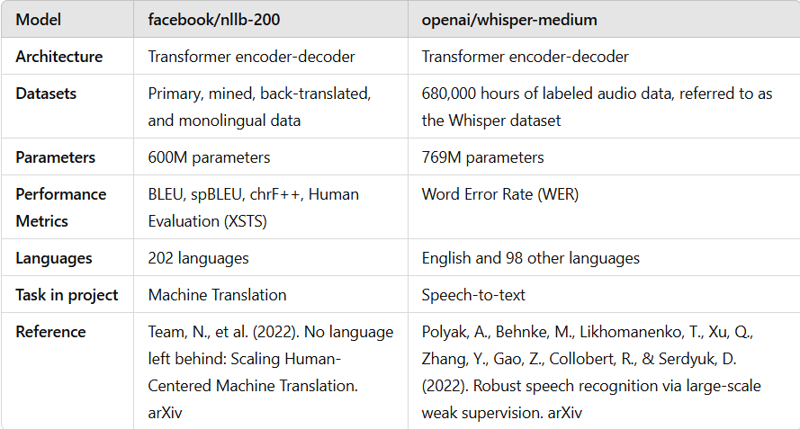
Model Details

Slide 7
Business Domain
Target Audience:
Individuals: People looking for easy ways to transcribe, translate, and analyze emotions in conversations, speeches, or personal notes.
Businesses: Companies dealing with customer support, client feedback, or market research where understanding customer sentiment is crucial.
Content Creators: Influencers, bloggers, or marketers who need fast and efficient multilingual transcription and translation, along with emotional insights from their audience.
Researchers and Analysts: Those conducting social media analysis or user behavior studies can use the app to understand emotional trends across different languages.

Slide 8





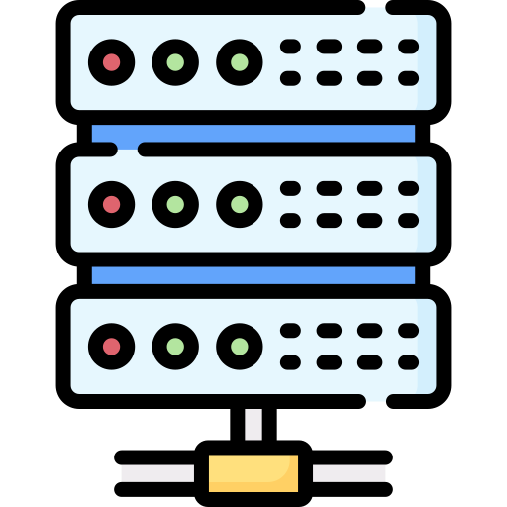
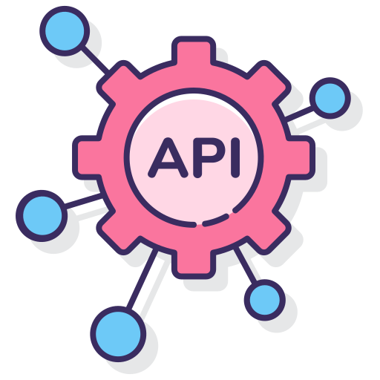





Project Timeline
FrontEnd
Development
Deployment
Pipeline Integration
Modules Building
BackEnd Development
APIs Integration
Documentation & Demos

Slide 9













Tools

Slide 10
Work load
Maya Ahmed Abdullah | Speech to Text Models
Zahy Youssef | Translation Models
Reem Al_Ghazal | Sentiment Analysis Models
Basma Elhoseny | Deployment
Youssef Hesham | Frontend
Usama Muhamma | Integration of Models

Slide 11


Explore Our Project
GitHub Repository: https://github.com/BasmaElhoseny01/DEPI-Project
Demo : http://48.217.82.28:8080/

Slide 12
THANK YOU

Slide 13
What is our project
A comprehensive application designed to facilitate speech processing, translation, and sentiment analysis.
1. Speech-to-Text Conversion
This feature enables users to transcribe spoken language into written text accurately in real-time. It supports:
Converts audio input (speech) into digital text.
Handles variations in accents and dialects to ensure high transcription accuracy.
Useful for applications like note-taking, interviews, or transcription for accessibility.
2. Translation
This feature facilitates seamless communication by translating the transcribed text between Arabic and English.
Converts transcribed text from Arabic to English and vice versa.
Preserves context and meaning, ensuring the translation is accurate and conversational.
3. Sentiment Analysis
Provide insights into the emotional tone of the conversation or text, classifying it as Positive, Neutral, or Negative.

Slide 14
How the Features Work Together
1. Speech Input: A user speaks in Arabic or English.
2. Transcription: The speech is converted into text using the Speech-to-Text module.
3. Translation: If needed, the transcribed text is translated to the target language (Arabic ↔ English).
4. Sentiment Analysis: The final text undergoes sentiment analysis to classify its emotional tone.

Slide 15
XXXXXXXXXXXXXX
33333333333

Slide 16

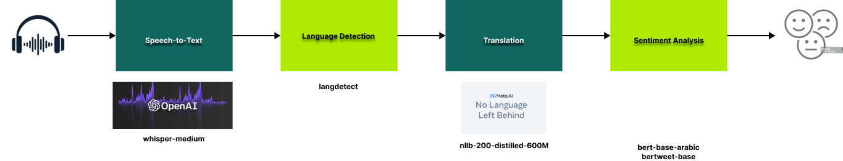
Project Pipeline

Slide 17
Tools

Slide 18
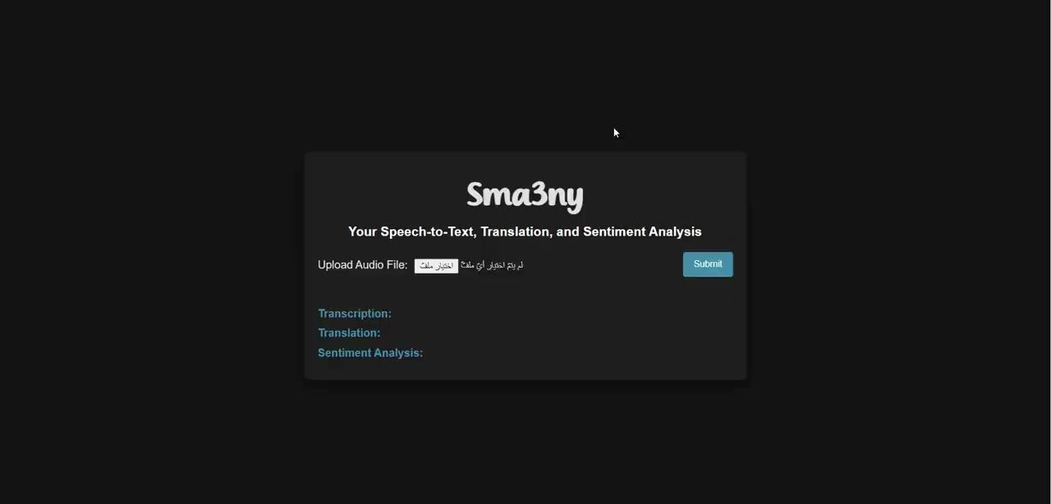
Demo

Slide 19
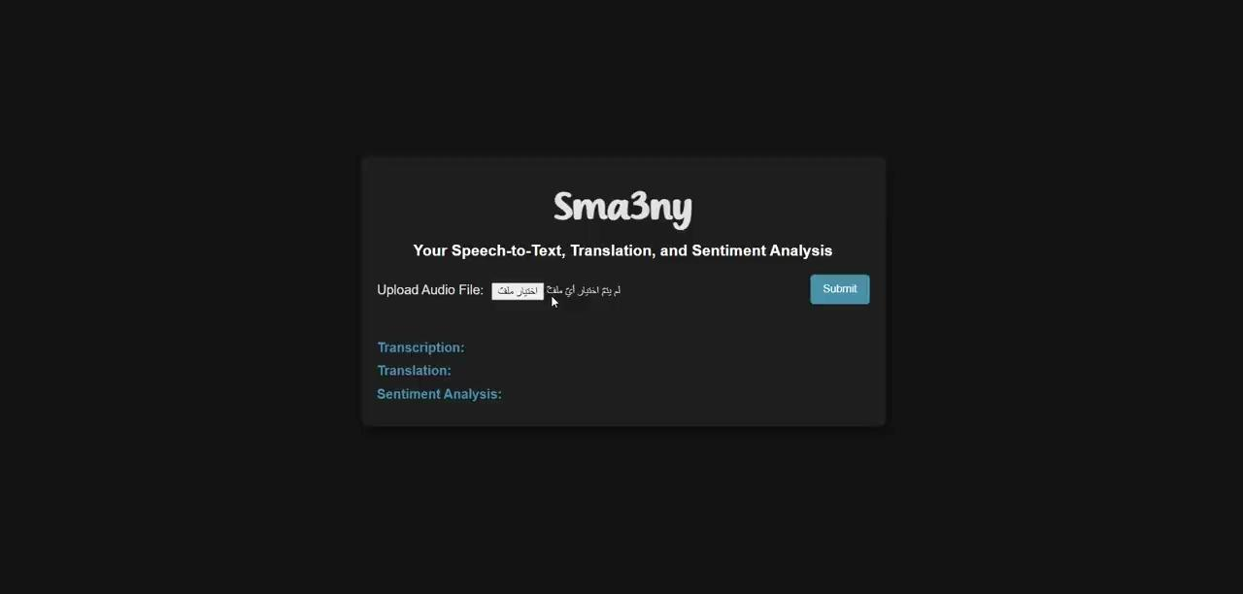
Demo

